Slide 1
Computer Modeling and Simulation
Lecture 22

Slide 2
Cellular Automata
Cellular automata (henceforth: CA) are discrete, abstract computational systems.
Firstly, CA are spatially and temporally discrete:
Spatially discrete: They are composed of a finite set of homogenous, simple units, the atoms or cells.
Temporally discrete: At each time unit, the cells instantiate one of a finite set of states. They evolve in parallel at discrete time steps, following state update functions or dynamical transition rules:. The rules dictate the update of a cell state by taking into account the states of cells in its local neighborhood.
Secondly, CA are abstract: they can be specified in purely mathematical terms and physical structures can implement them.
Thirdly, CA are computational systems: they can compute functions and solve algorithmic problems.
Despite functioning in a different way from traditional, Turing machine-like devices, CA with suitable rules can emulate a universal Turing machine , and therefore compute, given Turing’s thesis, anything computable.

Slide 3
Characteristics of a CA
A cellular automaton is a model of a system of “cell” objects with the following characteristics.
The cells live on a grid. (any finite number of dimensions.)
Each cell has a state. The number of state possibilities is typically finite. The simplest example has the two possibilities of 1 and 0 (otherwise referred to as “on” and “off” or “alive” and “dead”).
Each cell has a neighborhood. This can be defined in any number of ways, but it is typically a list of adjacent cells.

Slide 4
History of CA
The development of cellular automata systems is typically attributed to Stanisław Ulam and John von Neumann, who were both researchers at the Los Alamos National Laboratory in New Mexico in the 1940s.
Ulam was studying the growth of crystals and von Neumann was imagining a world of self-replicating robots.
Perhaps the most significant scientific work studying cellular automata arrived in 2002: Stephen Wolfram’s 1,280-page A New Kind of Science. Available in its entirety for free online, Wolfram’s book discusses how CA are not simply neat tricks, but are relevant to the study of biology, chemistry, physics, and all branches of science.

Slide 5
Modeling Complex Behavior
The mark of CA is in their displaying complex emergent behavior, starting from simple atoms following simple local rules.
Because of this, CA attract a growing number of researchers from the cognitive and natural sciences willing to study pattern formation and complexity in a pure, abstract setting.

Slide 6
Elementary CA
Simplest class of one-dimensional CA.
To understand Wolfram’s elementary CA, we should ask ourselves the question: “What is the simplest cellular automaton we can imagine?”
What’s exciting about this question and its answer is that even with the simplest CA imaginable, we will see the properties of complex systems at work.

Slide 7


Example of Elementary CA
Let’s build Wolfram’s elementary CA from scratch by building three key elements of a CA.
1) Grid. The simplest grid would be one-dimensional: a line of cells.
States. The simplest set of states (beyond having only one state) would be two states: 0 or 1.

Slide 8


Example of Elementary CA
Neighborhood. The simplest neighborhood in one dimension for any given cell would be the cell itself and its two adjacent neighbors: one to the left and one to the right.
So we begin with a line of cells, each with an initial state (let’s say it is random), and each with two neighbors.
For the time being, ignore the cells on the edges (since those have only one neighbor each.

Slide 9
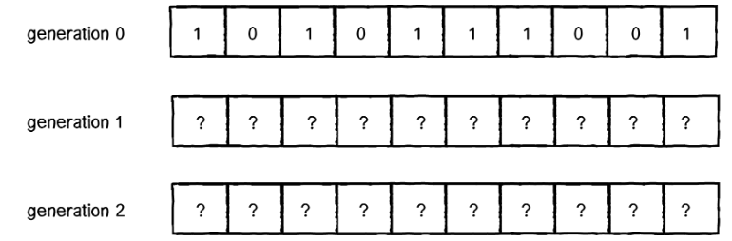
Transition Rules for a CA
We, now, observe the CA living over a period of time, which could also be called a generation or the frame count of an animation.
The figures in the previous slides show us the CA at time equals 0 or generation 0.
The questions we have to ask ourselves are: How do we compute the states for all cells at generation 1? And generation 2? And so on and so forth.

Slide 10
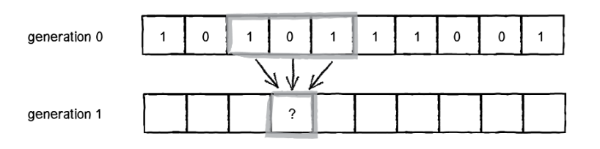
Transition Rules for a CA
Let’s say we have an individual cell called CELL. The formula for calculating CELL’s state at any given time t is as follows:
CELL state at time t = f(CELL neighborhood at time t - 1)
In other words, a cell’s new state is a function of all the states in the cell’s neighborhood at the previous moment in time (or during the previous generation). We calculate a new state value by looking at all the previous neighbor states.

Slide 11
Transition Rules for a CA
Now, in the world of cellular automata, there are many ways we could compute a cell’s state from a group of cells.
We can look at all the possible configurations of a cell and its neighbor and define the state outcome for every possible configuration.
We have three cells, each with a state of 0 or 1. How many possible ways can we configure the states?

Slide 12
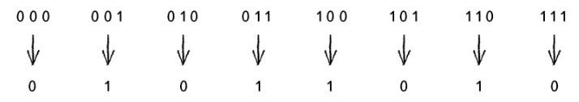
Transition Rules for a CA
Three cells define a 3-bit number, and how high can you count with 3 bits? Up to 8. Let’s have a look.
Once we have defined all the possible neighborhoods, we need to define an outcome (new state value: 0 or 1) for each neighborhood configuration.

Slide 13

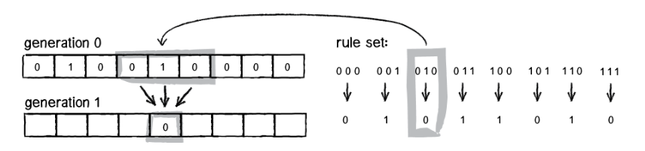
Transition Rules for a CA
The standard Wolfram model is to start generation 0 with all cells having a state of 0 except for the middle cell, which should have a state of 1.
Referring to the ruleset discussed earlier, let’s see how a given cell (let it be the center one) would change from generation 0 to generation 1.

Slide 14
Transition Rules for a CA
Try applying the same logic to all of the cells above and fill in the empty cells.
Now, let’s go past just one generation and color the cells —0 means white, 1 means black—and stack the generations, with each new generation appearing below the previous one.

Slide 15
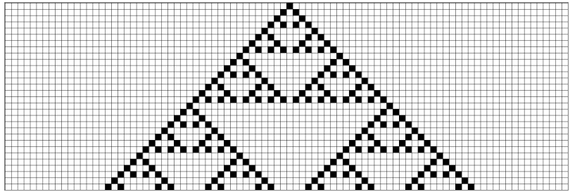
A CA over a no. of generations
The low-resolution shape we’re seeing above is the “Sierpiński triangle.”
Named after the Polish mathematician Wacław Sierpiński, it’s a fractal pattern.

Slide 16
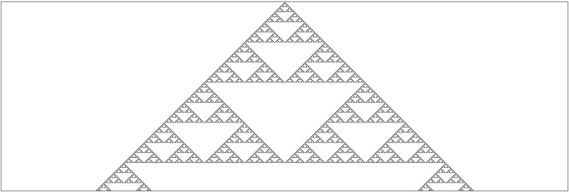
Here each cell is a single pixel wide so that the resolution is much higher.

Slide 17
Convention for naming Rules
The rule applied is called rule 90.
With 8 bit number, we have then 256 rules.
90 in binary

Slide 18
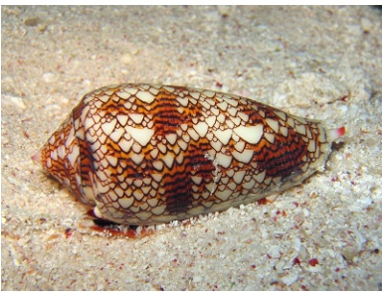
Outcomes of CA
Out of all 256 rule sets, only a handful produce compelling outcomes.
However, it’s quite incredible that even one of these rule sets for a one-dimensional CA with only two possible states can produce the patterns we see every day in nature (see the figure below), and it demonstrates how valuable these systems can be in simulation and pattern generation.

Slide 19
Random outcomes of CA
The Rule 90 gives this “Sierpiński triangle” only if the initial state contains only one 1 in the middle.
For different initial conditions, Rule 90 produce different results which are quite random.

Slide 20
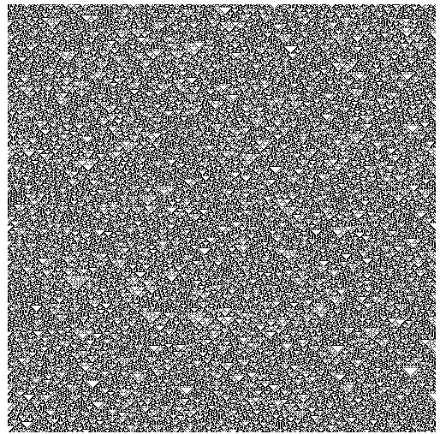
Rule 90 again. Same rule as above, but with a random initial condition. This time the individual cells are unpredictable

Slide 21
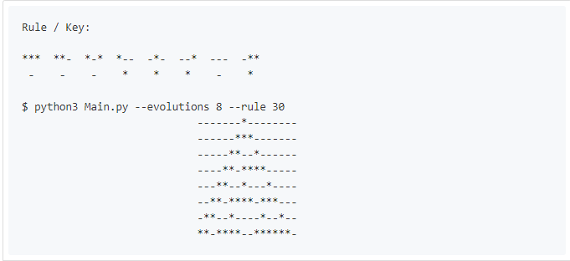
Another rule – Rule 30

Slide 22
Rule 30
For different initial states, the results never converge in rule 30.
In other words, rule 30 never begins to exhibit any pattern in its behavior that would allow someone to predict what cells were in what state at an arbitrary row without computing all the iterations prior by brute-force.
In rule 30, if we wanted to figure out what happens on the billionth row, we would actually have to generate all 1 billion rows, one by one.
For this reason, rule 30 actually served as the random number generator in Mathematica for a long time.

Slide 23
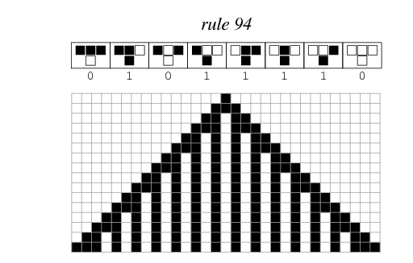
Rule 94
Most CAs don’t have this random behavior; they converge to well-defined patterns. Take rule 94:

Slide 24
Complex System
CAs model complex systems
More than the sum of its parts, a complex system is a system of elements, operating in parallel, with short-range relationships that as a whole exhibit emergent behavior.

Slide 25
2D CAs
Most popular example is Game of Life.

Slide 26
Turing Machine
A Turing machine is a mathematical model of computation that defines an abstract machine, which manipulates symbols on a strip of tape according to a table of rules.
Despite the model's simplicity, given any computer algorithm, a Turing machine capable of simulating that algorithm's logic can be constructed.[

Slide 27
Universal Turing Machine
In computer science, a universal Turing machine (UTM) is a Turing machine that simulates an arbitrary Turing machine on arbitrary input. The universal machine essentially achieves this by reading both the description of the machine to be simulated as well as the input to that machine from its own tape.

